Slide 1
Topic: Time EQ: How Do I calculate Elapsed Time?
Year 11 Mathematics Essentials

Slide 2
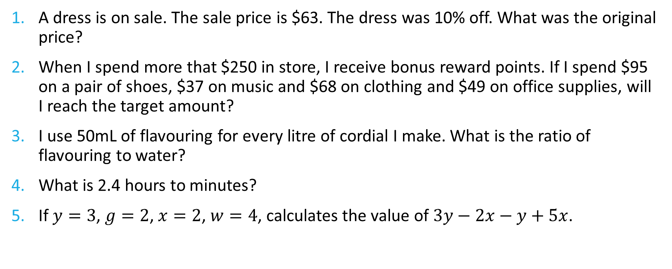
Five Questions
Topic: Time
Date: XX/XX/2021
EQ – How do I convert between 12 hour and 24 hour time?
A dress is on sale. The sale price is $63. The dress was 10% off. What was the original price?
When I spend more that $250 in store, I receive bonus reward points. If I spend $95 on a pair of shoes, $37 on music and $68 on clothing and $49 on office supplies, will I reach the target amount?
I use 50mL of flavouring for every litre of cordial I make. What is the ratio of flavouring to water?
What is 2.4 hours to minutes?
If $y=3$, $g=2$, $x=2$, $w=4$, calculates the value of $3y−2x−y+5x$.
Notes:
$70
No
50:950 = 1:9
144 minutes
22

Slide 3
24
7
30
Date: XX/XX/2021
Topic: Time
EQ – How do I calculate elapsed time?
What is elapsed time?
Elapsed time is the amount of time that passes from the start of an event to the end of an event.
Example: For 3:50am and 9:30am, elapsed time is ____ hrs, ____ mins
There are many methods to working out elapsed time. We will be focusing on two methods:
Number line or timeline method
Table method
You can choose the best method out of these to calculate time that best suits you.
WICOR

Slide 4
24
7
30
Date: XX/XX/2021
Topic: Time
EQ – How do I calculate elapsed time?
Number Line or Timeline Method
https://www.youtube.com/watch?v=ML6r7BEZo7M
WICOR
Notes:
Stop video at key points to allow students to take notes and worked examples.

Slide 5
24
7
30
Date: XX/XX/2021
Topic: Time
EQ – How do I calculate elapsed time?
Table Method
https://www.youtube.com/watch?v=pvZ6F6IHAIw&t=0s
WICOR
Notes:
Stop video at key points to allow students to take notes and worked examples.

Slide 6
Task – Interleaved Maths Text
86. Calculating with time: Hours and Minutes p. 120
Complete Questions 1 – 9 using the Number Line Method
Complete Questions 10 – 18 using the Table Method
**Ignore the instructions in the text on the strategies to use to answer the set questions

Slide 7
Task – Interleaved Maths Text
88. Calculate elapsed time and time intervals
Complete Questions 1 – 12 using either the Number Line Method or Table Method
Working out must be shown to demonstrate your thinking.

Slide 8
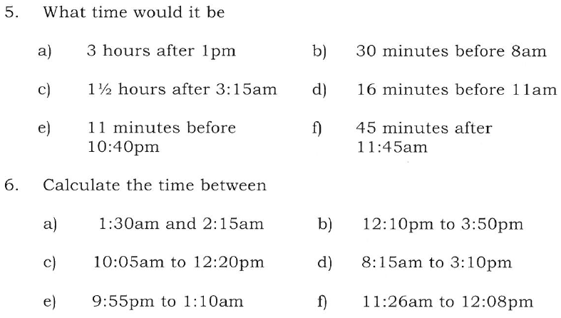
Further Practice

Slide 9
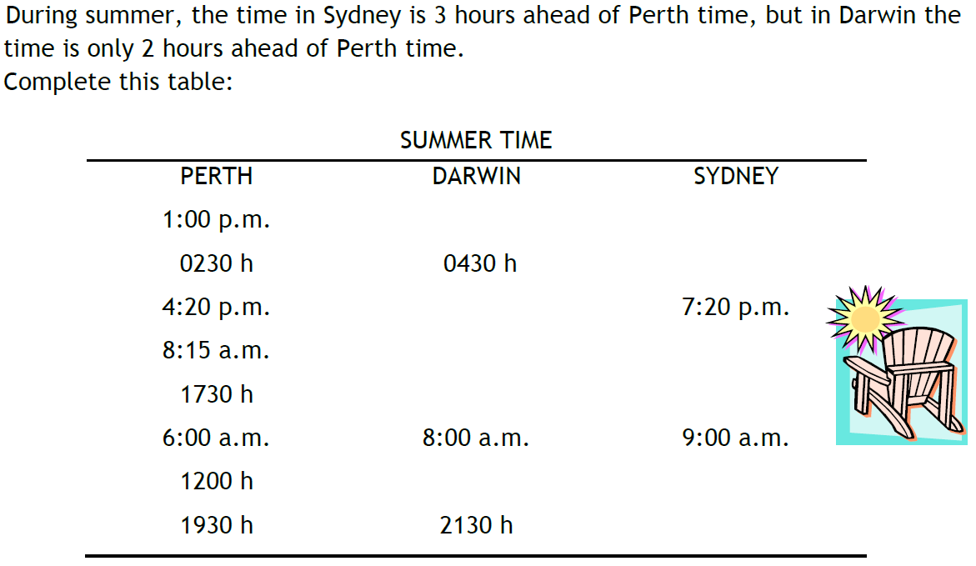
Questions in context

